Slide 1
Call Performance Dashboard
File created on: 3/19/2024 9:05:25 AM

Slide 2
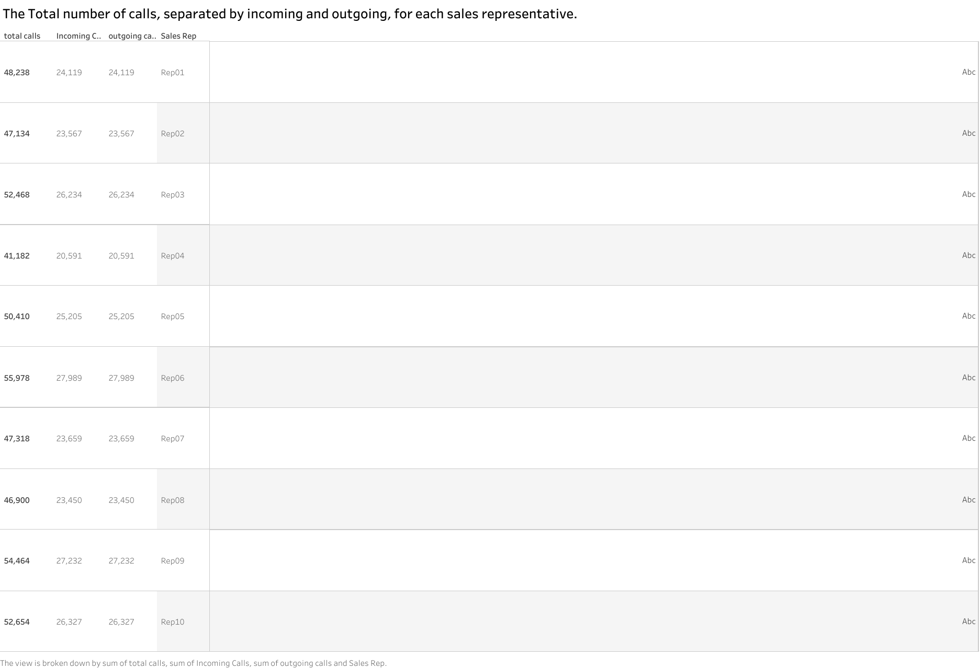

Slide 3
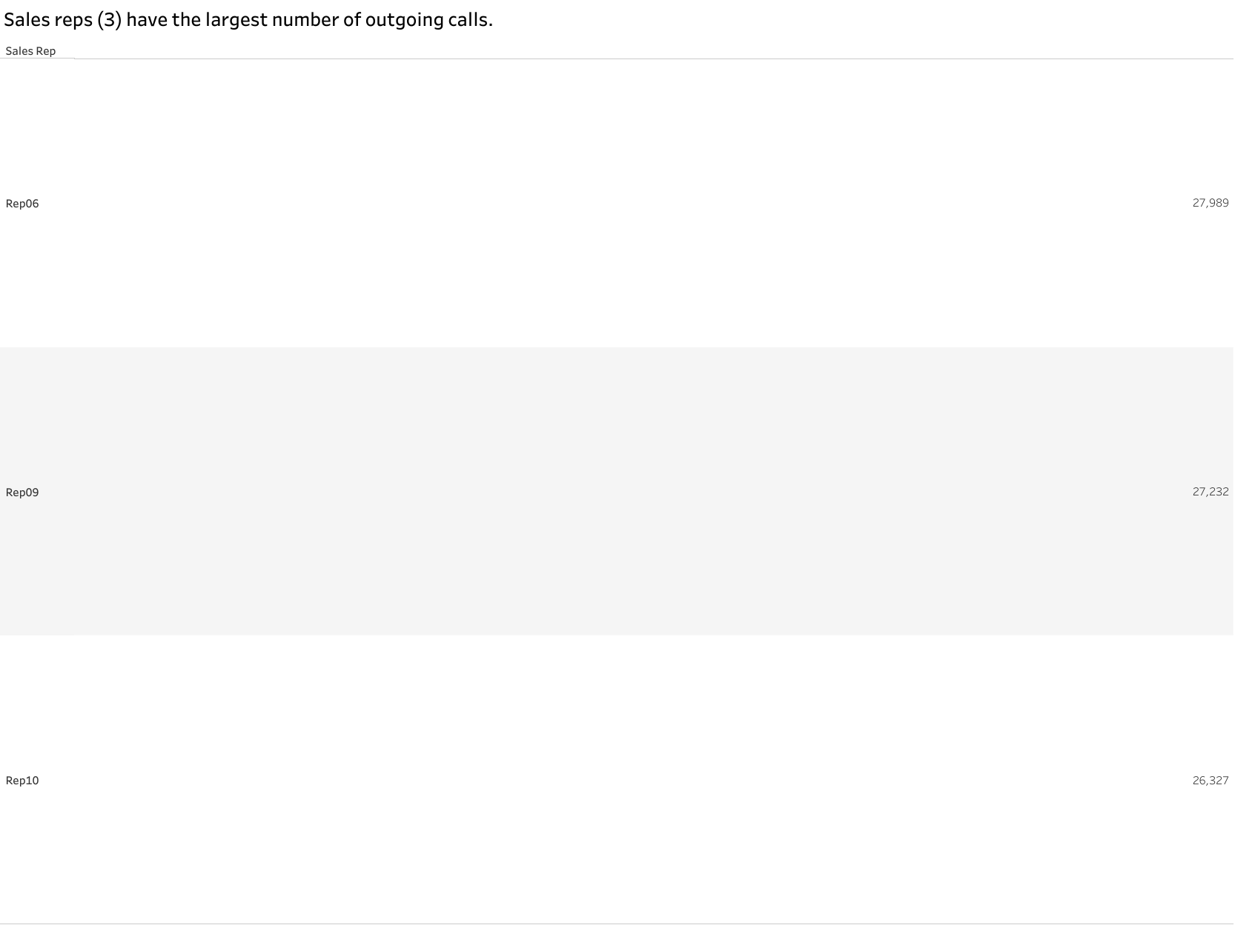

Slide 4
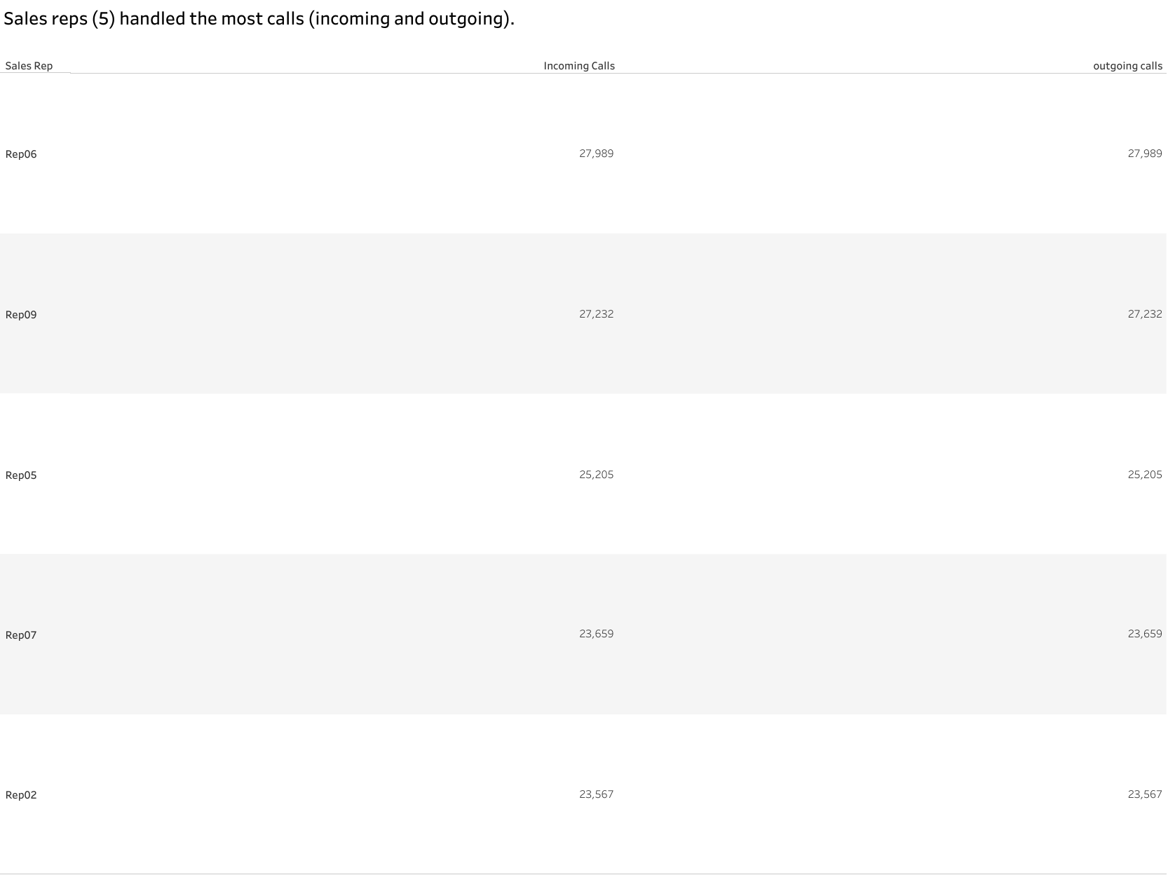

Slide 5
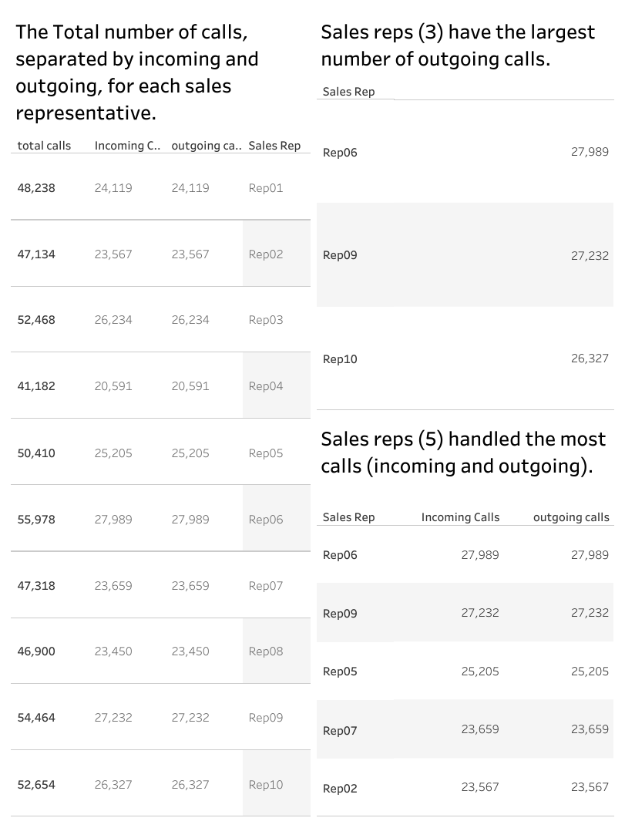

Slide 6
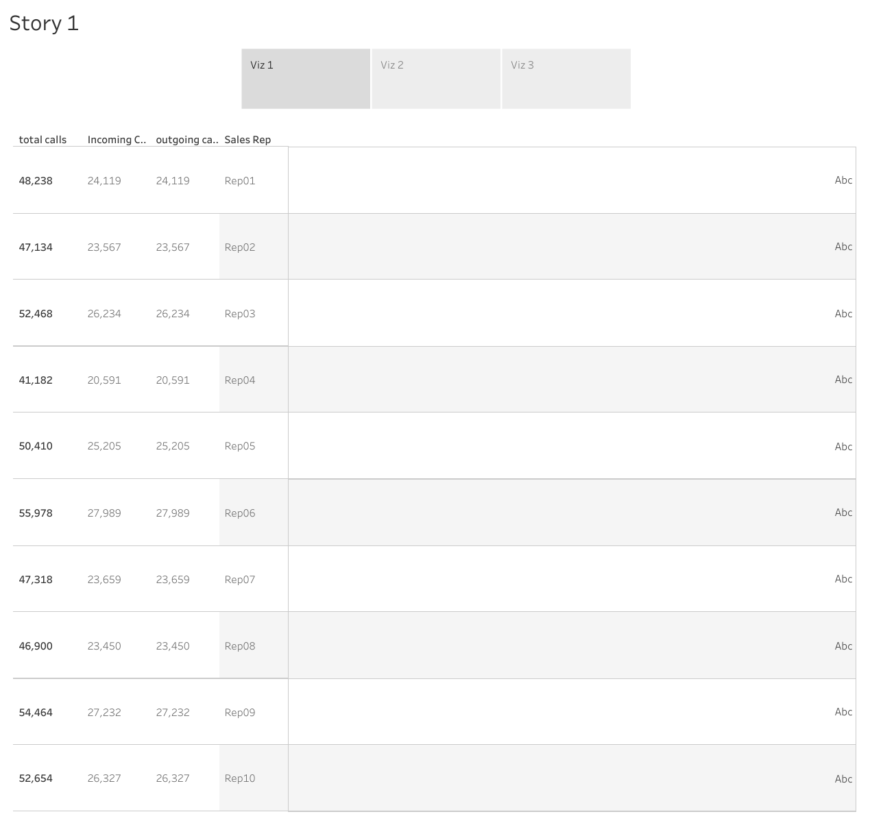

Slide 7
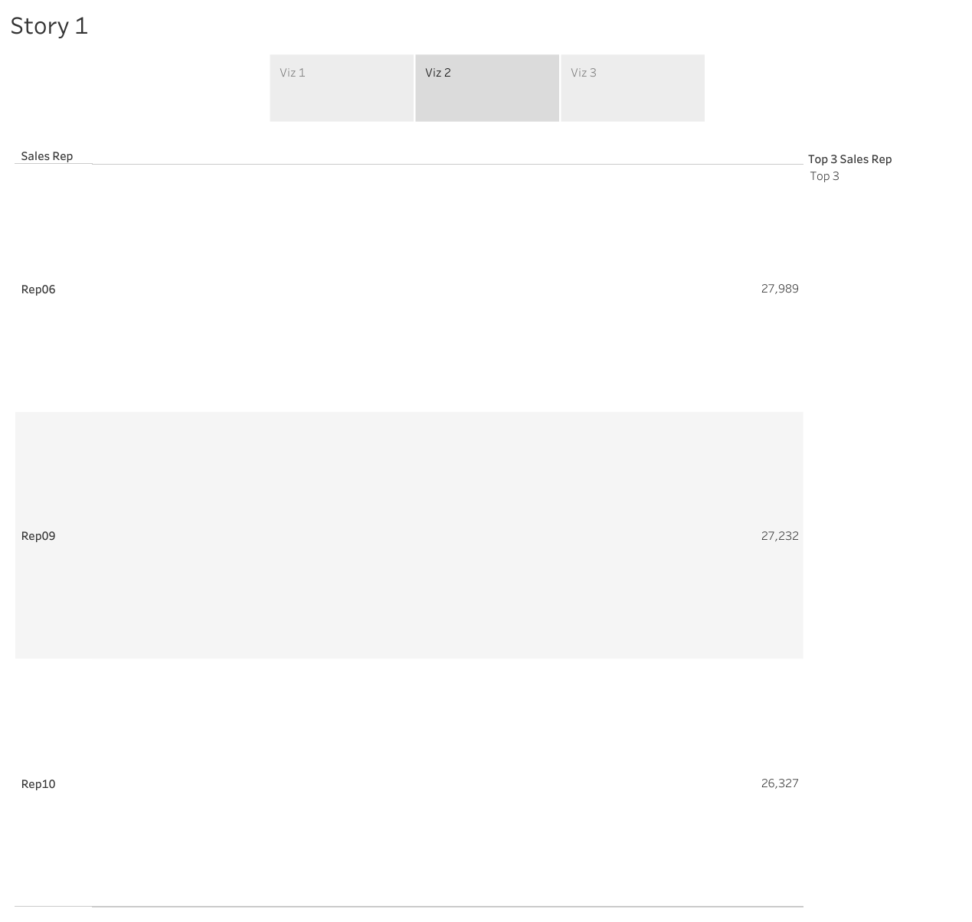

Slide 8
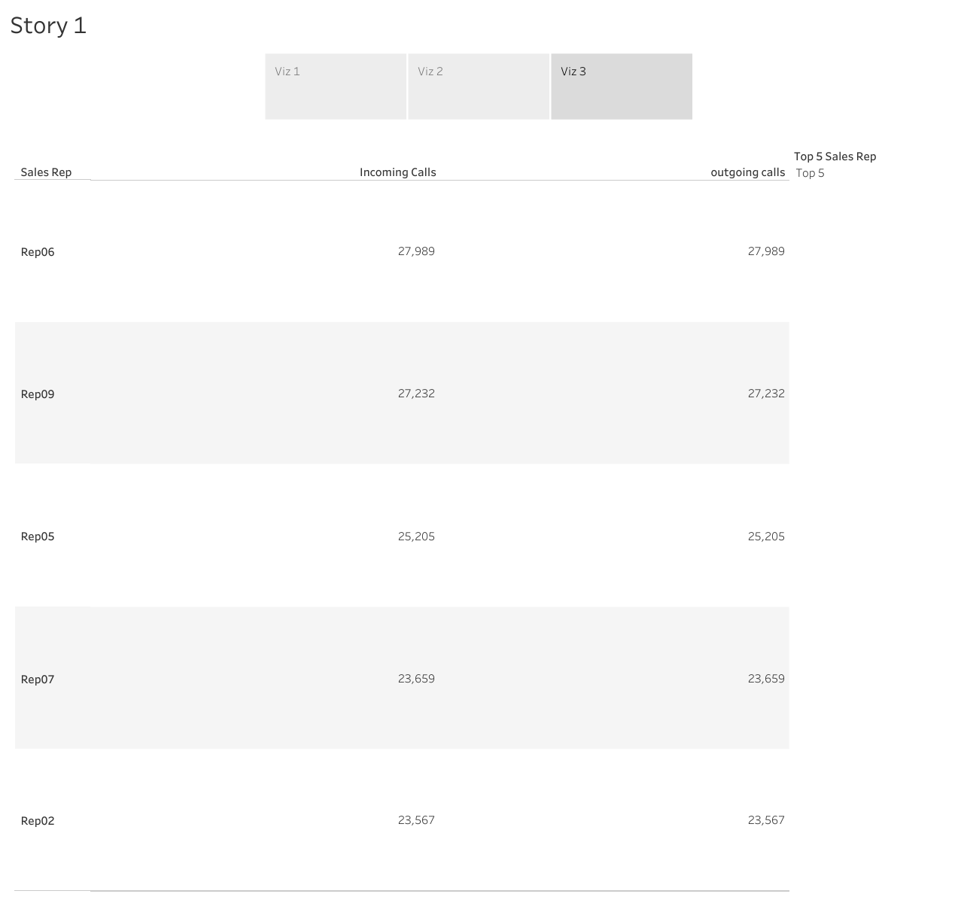

Slide 9
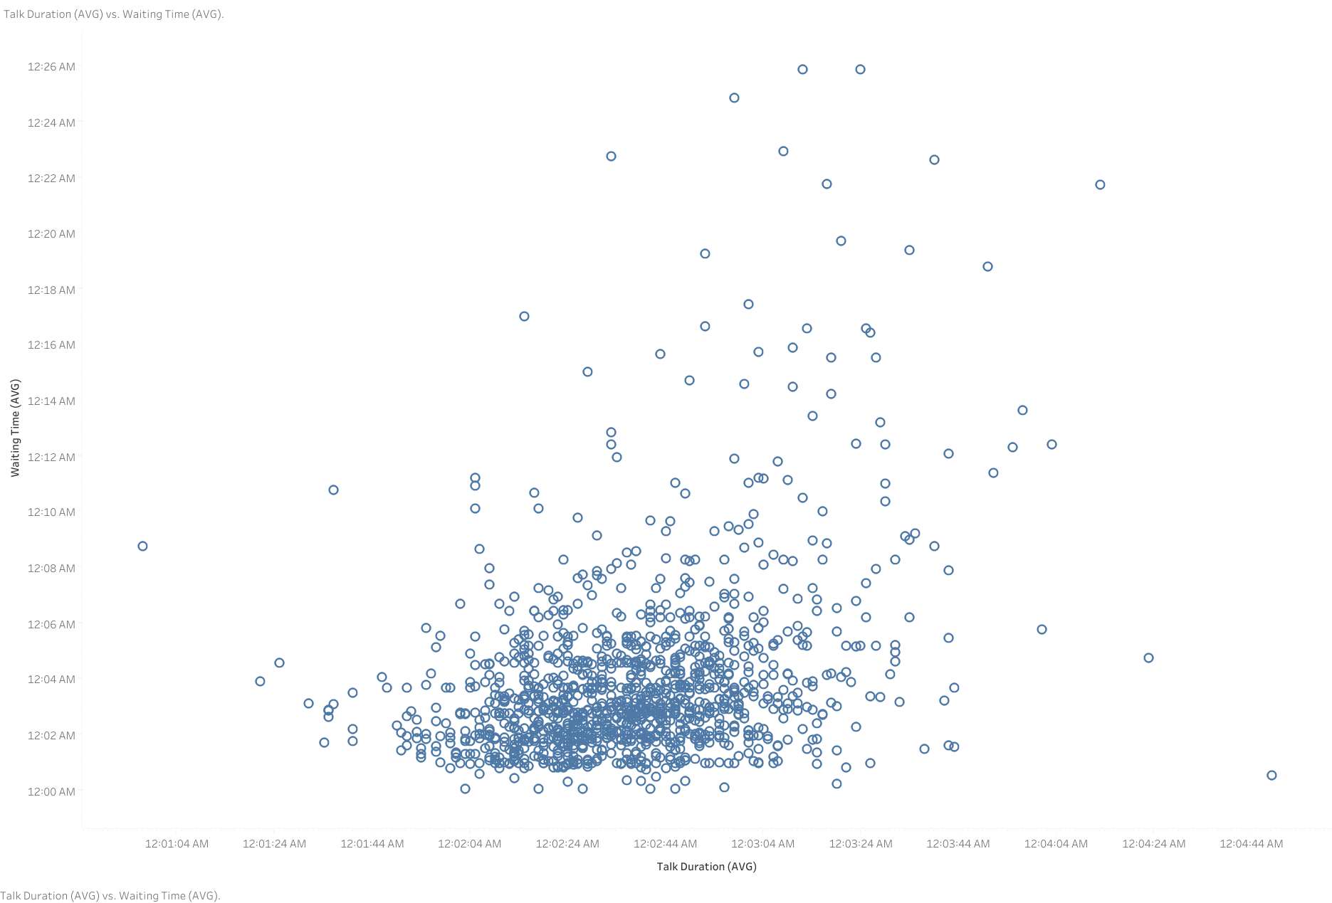

Slide 10
Tableau Public URL of the dashboard
https://public.tableau.com/views/CallPerformanceDashboard_17108389447670/viz1?:language=en-US&publish=yes&:sid=&:display_count=n&:origin=viz_share_link

